Slide 1
Family Business Transitions - Adding the PE Sponsor
Every family led business faces inflection points—moments when size, stage, market conditions, or family dynamics demand a new way of operating.
Whether navigating a post-acquisition shift, accelerating toward scale, or recovering from disruption, these transitions often surface uncertainty, misalignment, and organizational strain.
The Right resource, doing the Right activity, executed in the Right way,

Slide 2
Living in the PE World – Human Capital Approach
Private Equity - Growth
Accelerate value creation during the hold period
Enabling Growth
Companies being acquired and investment thesis to achieve
Size, Maturity and Capabilities
Examples:
Founder Led ($5-$40M)
First Flip ($100-$200M)
Second Flip ($300-$500M)
Third Flip ($500M-$1B)
People strategies contribute significantly to the company's growth and attractiveness to future PE buyers:
Support business to achieve financial thesis
Build people plan to capture additional value
Assess and manage employment risk
Build the desired company culture for growth

Slide 3
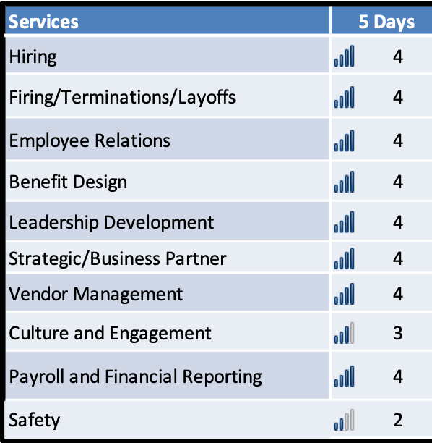
Fractional HR Approach – Where to Focus?
1-5
Some Examples of Support
HR levers to create value (invest/divest/improve)
First day welcome and communication
New leader welcome and alignment to the business
Hiring practices and onboarding
PE business acumen for HR team/payroll
First Line Manager People Leadership Skills
Change Management – Manage Expectations
Managing Risk – Managing employment risk
Headcount Management and Rationalization (RIFs)
Benefit, payroll and HR practices alignment
First 90 Days after deal – Project Management
Installing Learning Management Platform
HR compliance audit to close findings
HR playbook for growth
Cover Basics: Goals + Bonus Plans + Reporting + handbook + Safety + Harassment
Building aligned metrics and core story for flip

Slide 4
Business Stage- Typical People Practices
Creating a detailed table to showcase the evolution of HR capabilities across different stages of a company's growth, especially for a company like US Waterproofing aiming to grow significantly, is a complex task. Each stage of maturity, from a Founder-Led Business to the third Private Equity (PE) flip, demands specific HR strategies and functions to enhance the company's value and appeal to future PE buyers.
Here's a structured representation of the table, populated with specific HR capabilities at each level:
HR Capabilities | Founder-Led Business ($0-40M) | PE First Flip ($100-$200M) | PE Second Flip ($300-$500M) | PE Third Flip ($500M-$1B)
Talent Acquisition | Basic recruiting strategies, focused on essential roles. | Structured recruitment processes, including talent branding. | Advanced talent acquisition, global talent sourcing. | Strategic global talent acquisition, sophisticated executive search.
Leadership Development | Informal leadership mentoring. | Formal leadership development programs, including management training. | Advanced leadership training, succession planning, global leadership initiatives. | Executive coaching, global leadership development programs.
Organizational Design | Simple, flat organizational structure. | Developing middle management layers, initial departmental structuring. | Complex structures, including global teams and divisions. | Agile, flexible organizational structures for global scalability.
Payroll Management | Basic payroll processing. | Automated payroll systems, initial outsourcing for efficiency. | Integrated payroll systems, international compliance. | Global payroll strategies, complex software solutions.
Benefits Administration | Basic benefits package. | Enhanced benefits, focus on “employer of choice” and cost savings from scale | Comprehensive benefits, including international packages. | Global benefits strategy, customized benefit packages.
Employee Relations | Direct founder-employee engagement. | Formal HR presence, employee engagement strategies. | Advanced HR teams, focus on employee experience and engagement. | Global HR policies, cultural integration, employee advocacy.
Learning & Development | On-the-job training, basic skills development. | Structured L&D programs, online learning platforms. | Advanced L&D platforms, leadership academies, global training initiatives. | Global L&D initiatives, continuous learning culture, advanced digital platforms.
Compliance | Basic legal compliance, local regulations. | Comprehensive compliance strategies, multi-state focus. | International compliance, risk management frameworks. | Global compliance frameworks, proactive risk assessment and management.
HR Technology | Basic HR software for administration. | Integrated HRM systems, initial data analytics. | Advanced HRIS, AI-driven analytics, workforce planning tools. | HRIS and People Analytics a separate functional area in HR. Extensive report
Data | Payroll register related reports | Emerging set of people analytics around core metrics (e.g., turnover) and some predictive analytics from HRIS | Advanced HRIS report capability tied to business and other financial metrics. HR data feeds other tools. AI Predictive | Integrated global D&I initiatives, leadership accountability, diverse workforce strategy.
Strategic HR Planning | Basic HR planning aligned with business goals. | Strategic HR alignment with business growth and PE objectives. | Long-term HR strategic planning, global workforce planning. | Global HR strategy, aligned with corporate vision and global market trends.
Performance Management | Basic performance reviews, informal feedback. | Structured performance management systems, KPI-driven evaluations. | Advanced performance metrics, global performance management systems. | Global performance management, integrated with business outcomes, data-driven feedback.
HR Analytics | Limited use of analytics. | Developing HR analytics for decision-making. | Advanced analytics for workforce planning and talent management. | Predictive analytics, strategic decision-making based on data insights.

Slide 5
Approach to HR
Be About Growth!
Ensure the business thrives in the market
Leadership
Managers
Employees
Sponsor
PURPOSE OF HR
Ensure we make decisions about TALENT, LEADERSHIP and ORGANIZATION with the same rigor, logic and confidence as decisions about money, customers, products and technology
People Strategy/Culture/Values
Capability/Succession/Investments
Leadership/Organization/Talent
Skill-Building
Talent Pipeline
Performance Management
Employee Services
Employee Benefits
Career development
Approach to EBITDA
Scalable and digital infrastructure
Compliance and Risk Practices
Cost, Supplier Management and ROI
Culture, Change Management and Communication
Everyone Serves a Customer
Notes:
Vision/Mission HR - We Are About Growth.
Purpose: We enable the business by help us making better decisions about people, organization and culture
Customer Focus: HR is not about HR, but about delivering value to all stakeholders inside (e.g., employees, managers, senior leaders, business strategy) and outside (customers, investors and communities)

Slide 6
Example
People Strategy– Gaining maximum value at time of flip
Capabilities | Today - Level | Strategy in place | Status
Above average technician retention (70%) | Varies by business. Average of 51% retention | Beginning to measure turnover trailing 3 months
Formal training Continuing Professional Education (CPE) and active recruiting | Below fundamental | None
Processes in-place to consistently recruit, train and retain top performer at scale | Fundamental | HR team has processes. Hiring managers don’t have
Ability to match consumer demand with available in-field technician/work force capability | Fundamental | Limited ability to move across geographies and businesses
Deep bench of talent and tenured management team | Fundamental | Talent assessment
Culture drive, deep manage teams capable of running larger service organization | Fundamental | Leadership index.
Strong operators with track record of execution | Fundamental | Proof is ability to execute plan
M&A due diligence and integration for people | Advanced | Yes
Core People Processes. Talent management, performance management, goal setting, pay increase planning, recruiting process, training and development and employee engagement, HRIS and automation | Fundamental and intermediate | Performance management, planned process moving across all business brands
Not
Started

Slide 7
Building Metrics. Progress Report: People Metrics Key Measures of People Performance
Relevant
Strategic Business
Impact Metrics
Workforce Impact Metrics
Operational Efficiency Impact Metrics
Actionable
Over
200
Potential
HR
Measures
Metrics directly related to the organization’s bottom line and strategic objective to demonstrate | Metrics measuring how well the organization supports and enhances the workplace experience, which is critical for employee engagement and desired work culture | Metrics assessing the effectiveness and efficiency of HR process and practices
Ensure HR goals are aligned with business objective. | Measure and improve engagement and retention strategies | Identify inefficiencies and bottlenecks to streamline HR processes. Optimized resources allocation
Examples
Feed people platform metrics in Data Lake to feed other business metrics + ADP Dashboard | Employee Net promoter score Unwanted employee turnover | Payroll/HRIS per employee Cost per hire Health Care Cost per employee
82 ADP Metrics for USW Holdings
Measures
< 20
Business
Scorecard
Data + Insights + Actions + Predictive Analytics = Impact

Slide 8
The CEO defines the playing field for HR
HR Leader | Business Leader
 | High HR/Low Leader Blocking – HR topics not discussed Slow to change Home grown practices prevail over better or best practices – can’t scale No seat at table Informed after– Not involved before Marginalize the impact of HR | High HR/High Leader HC strategy aligned to EBITDA “Mirror” for the CEO Coach to Leaders Goal clarity + Performance + Culture + Company Values Respect for the function Consistent HR execution
 | Low HR/Low Leader Lower Employee Engagement Higher turnover Poor execution Pattern of execution misses Poor financial performance | Low HR /High Leader HR is transaction only Business leader not well-served HR is seen as an ineffective SG&A cost – “Don’t tell them anything” Reputation of HR gets trashed
Notes:
Vision/Mission HR - We Are About Growth.
Purpose: We enable the business by help us making better decisions about people, organization and culture
Customer Focus: HR is not about HR, but about delivering value to all stakeholders inside (e.g., employees, managers, senior leaders, business strategy) and outside (customers, investors and communities)

Slide 9
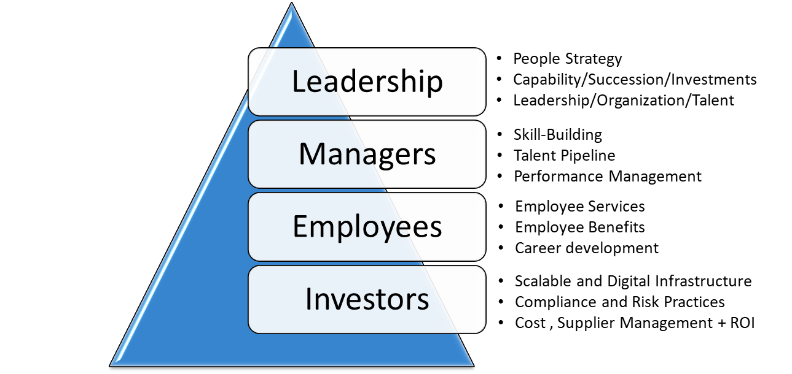
Building Future – Typical HR Capabilities - $125M+
Recruit New Employees
Develop Employees
Source Talent
Assess and Hire Talent
Job Boards and ATS
Onboarding
Build LMS
Capabilities
Develop Training
Develop critical talent
Develop Leaders
Manage Performance
Level of Maturity
Business
Coaching
Build HR Capabilities to Support Growth
Succession Planning
Differences by individual businesses we acquire
Color reflect overall level of proficiencies of “platform”
Red does not scale to $200M+
Business
Partner
Manage Existing Employees
Career Paths and Mobility
Vision for HR
Ensure we make decisions about TALENT, LEADERSHIP and ORGANIZATION with the same rigor, logic and confidence as decisions about money, customers, products and technology
Recognition
Employee
Engagement
Employee
Communication
High Potentials
Build Now
HR Delivery Model
HRIS Capability
M&A Integration
Communication
Talent Pipeline
Compliance + Risk
L&D and LMS
Safety Framework
Benefits Platform
People data analytics integrated into business performance metrics
Manage the Workforce Strategy
EEO and Diversity
Time and Attendance
Safety
Manage
Risk
Vendor Performance
Employee
Relations
General
Ledger
Ensure the business thrives in the market
Total Rewards
Tax and Compliance
Leave of Absence
Payroll
Processing
HRIS
M & A
ERISA
Benefit laws
Comp
Framework
Design Benefits
Deliver Benefits
Manage the Function
Manage Employee Rewards and Benefits

